Slide 1
String in Java

Slide 2
What is String in Java?
Generally, String is a sequence of characters.
But in Java, string is an object that represents a sequence of characters.
The java.lang.String class is used to create a string object.

Slide 3
There are two ways to create string in Java:
1. String literal
2. String object;
String literal:
String object;
Ex: String s;
String object=“value”;
Ex:
String s = “GeeksforGeeks”;

Slide 4
Using new keyword
String object=new String();
Ex: String s=new String();
String object=new String(“value”);
String s = new String (“GeeksforGeeks”);

Slide 5
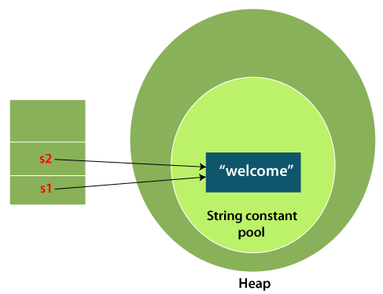
String s="welcome";
Each time you create a string literal, the JVM checks the "string constant pool" first.
If the string already exists in the pool, a reference to the pooled instance is returned.
If the string doesn't exist in the pool, a new string instance is created and placed in the pool.
For example:
String s1=“welcome";
String s2=“welcome";

Slide 6
Methods:
int length():
Returns the number of characters in the String.
int variable=Stringobject.length();
charAt()
returns a char value at the given index number.
char variable=Stringobject.charAt(index no);

Slide 7
String substring():
This method has two variants and returns a new string that is a substring of this string.
String object2=Stringobject1.substring(indexno);
String object2=Stringobject1.substring(startindex, endindex);
concat()
method concatenates one string to the end of another string. This method returns a string with the value of the string passed into the method, appended to the end of the string
String object3=Stringobject1.concat(Stringobject2);

Slide 8
indexOf()
This method returns the index within this string of the
first occurrence of the specified character or string
if the character or string does not occur, returns -1
int variable=Stringobject.indexOf(char variable/String1);
Int lastIndexOf( String s):
Returns the index within the string of the last occurrence of the specified string.
int variable=Stringobject.lastIndexOf(char variable/String1);

Slide 9
boolean equals( )
Compares string to another string
boolean variable=Stringobject1.equals(StringObject2)
boolean equalsIgnoreCase (String anotherString)
Compares string to another string, ignoring case considerations.
boolean variable=Stringobject1.equalsIgnoreCase(StringObject2)

Slide 10
int compareTo( String anotherString):
Compares two string lexicographically
int variable=String1.compareTo(String2);
If 2 strings equal return - 0
If string1 is smaller than string2 < 0
If string1 is larger than string2 > 0
int compareToIgnoreCase( String anotherString):
Compares two string lexicographically, ignoring case considerations.
int variable=String1.compareToIgnoreCase(String2);
If 2 strings equal return - 0
If string1 is smaller than string2 < 0
If string1 is larger than string2 > 0

Slide 11
String toLowerCase():
Converts all the characters in the String to lower case
String2=String1.toLowerCase();
String toUpperCase():
Converts all the characters in the String to upper case
String2=String1.toUpperCase();

Slide 12
String trim():
Returns the copy of the String, by removing whitespaces at both ends.
String2=String1.trim();
String[] split():
Splits the line of String into array of strings separated by delimiter
String object[]=String1.split();
default delimiter is space
String object[]=String1.split(“delimiter”);

Slide 13
valueOf()
method converts different types of values into string.
By the help of string valueOf() method,
you can convert int to string, long to string, boolean to string, character to string,
float to string, double to string, object to string and char array to string.
String object=String.valueOf(int/long/float/double/boolean/char array)

